Slide 1
Pipeline
How to make it and possibly crash

Slide 2
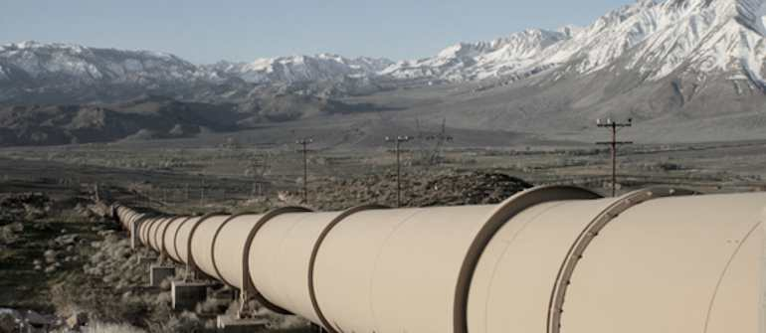
What is a Pipeline ?
A pipeline is a concept that works for continuous:
Integration
Deployment
Delivery
As a software strategy that enables organization to deliver new features to users as fast and efficiently as possible.

Slide 3
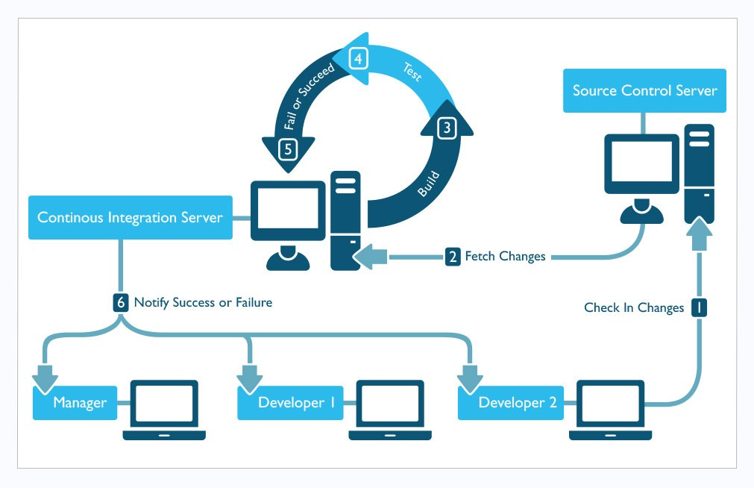
Continuous Integration

Slide 4
Continuous Integration
Is the practice of integrating changes from different developers in the team into a mainline as early as possible, in best cases several times a day.
This makes sure the code individual developers work on doesn’t divert too much.
When you combine the process with automated testing, continuous integration can enable your code to be dependable.

Slide 5
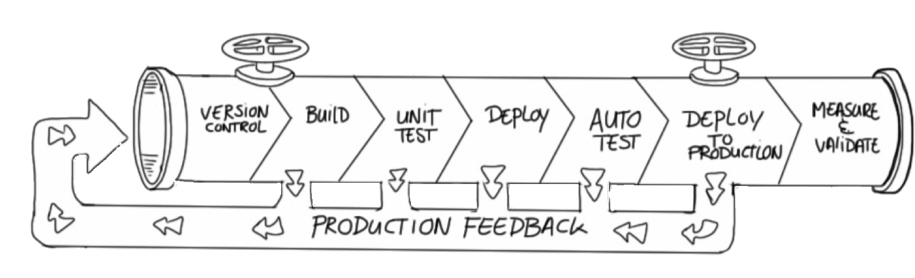
Continuous Deployment
Is closely related to Continuous Integration and refers to keeping your application deployable at any point or even automatically releasing to a test or production environment if the latest version passes all automated tests.
?

Slide 6
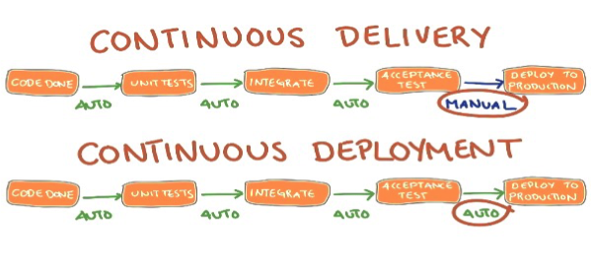
Continuous Delivery
Is closely related to Continuous Integration and refers to keeping your application deployable at any point or even automatically releasing to a test or production environment if the latest version passes all automated tests.

Slide 7
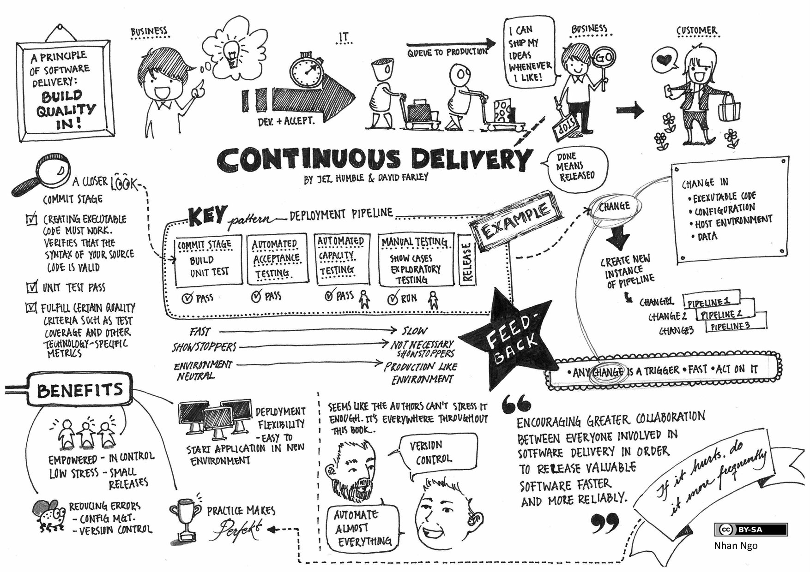
Business With Continuous Delivery

Slide 8
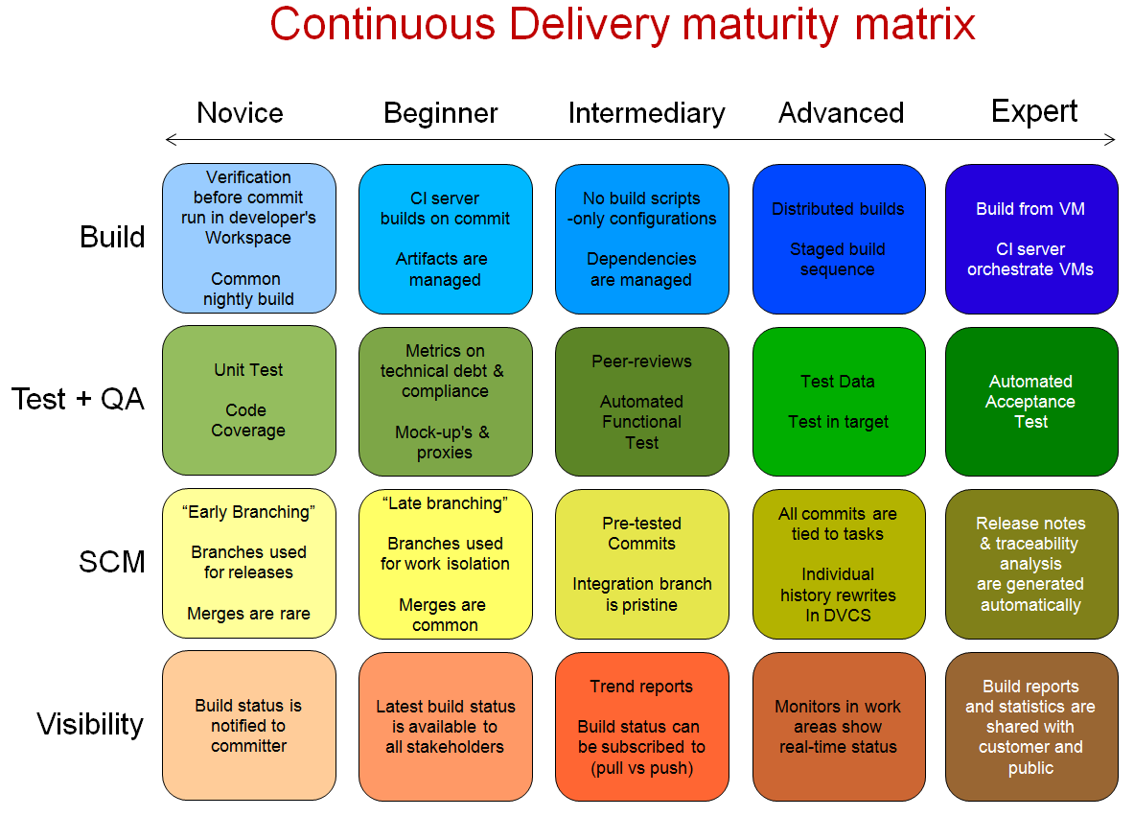

Slide 9
Free Open Source CI Services https://github.com/ligurio/Continuous-Integration-services/blob/master/continuous-integration-services-list.md Open Source Deployment Service https://github.com/integrations/feature/deployment

